Slide 1

Improving Text Extraction Accuracy with Image Preprocessing
Under the guidance of Dr. T. Sridevi
BE2102-07
1601 18 733 067
1601 18 733 081

Slide 2
Agenda
Introduction
Problem Statement
Methodology
Architecture
Application

Slide 3
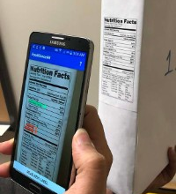
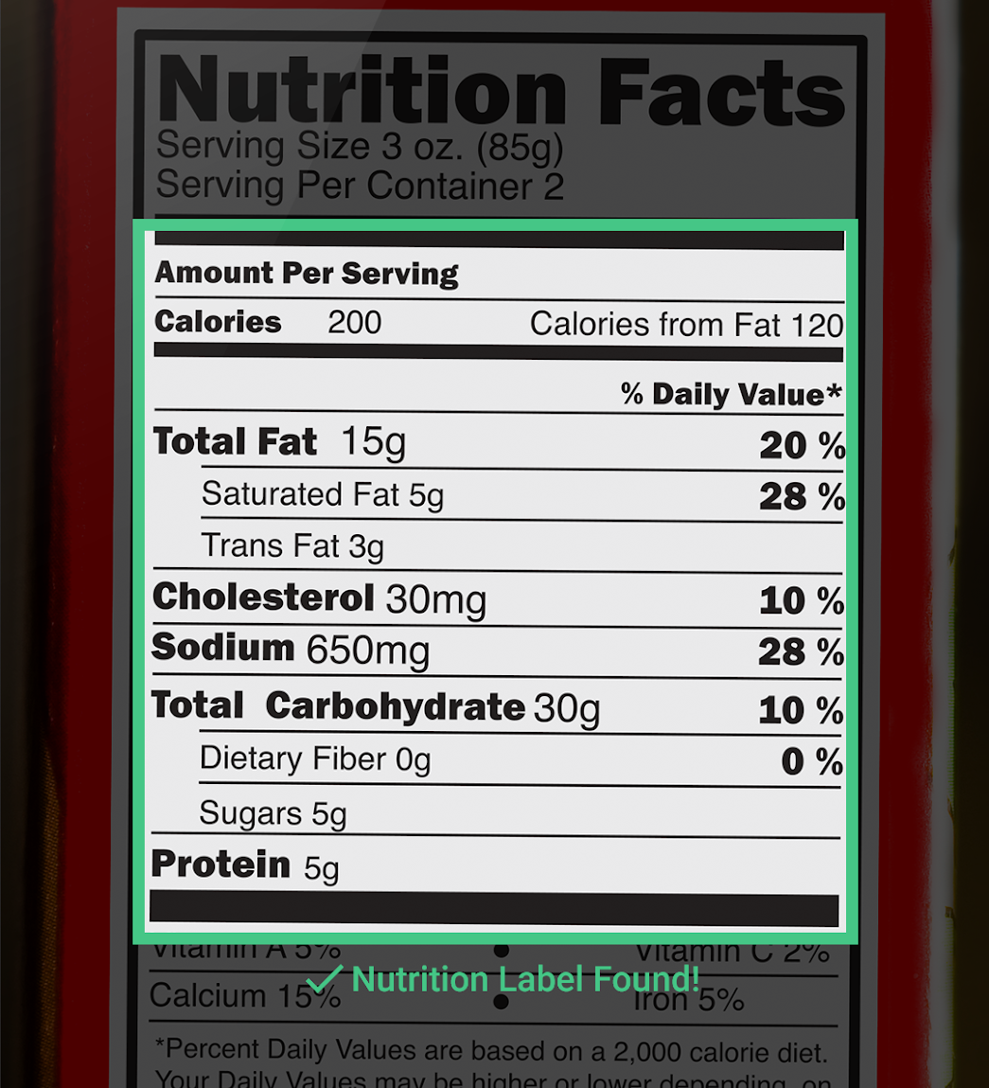
Advancements in computer vision have paved the way by providing tools for text detection and extraction. We observed that the accuracy of the extracted text is relatively low and contains a lot of noise. The aim is to extend the current pipeline to improve the accuracy by
Improving the quality of the image
Using NLP to extract information from raw text

Slide 4
The Problem with Traditional OCR Methodology
Notes:
Soumya

Slide 5







Traditional Optical Character Recognition
Document
Scan
Scanned Image File
OCR
Text Document
Notes:
Soumya

Slide 6
Historical OCR engines have their accuracy lying between 70-80% for a high quality image at the page level.
That means in a page of 100 words 70-80 words are accurate.
While this might seem high, it can cause significant inaccuracies if used on a large volume of sensitive documents.
Notes:
Soumya

Slide 7
How can we increase the existing accuracy?

Slide 8



Scanned Image File Upload
Image Preprocessing Pipeline
Optical Character Recognition
Text Extraction
Information Extraction
Text - to - Speech Conversion
Document
Scan
Notes:
Preprocessing pipeline workflow
Speech to text

Slide 9
Architecture
Notes:
Komali

Slide 10
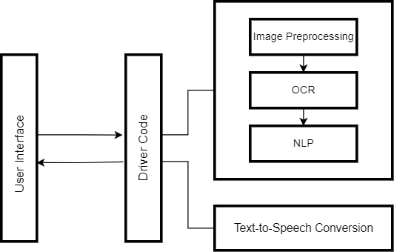
Architecture
Notes:
Komali
Tell which lang/packages/technologies

Slide 11
Scanned Image File Upload
Image Preprocessing Pipeline
Optical Character Recognition
Text Extraction
Information Extraction
Text - to - Speech Conversion
Document
Scan
Notes:
Soumya
Preprocessing pipeline workflow
Speech to text

Slide 12
Image Preprocessing

Slide 13
Image Preprocessing
Convert Image to Grayscale
Skewness Correction
Sharpening
Brightness Correction
Load Image
Is Grayscale Image?
Document Detection
Is Image Skewed?
Is Image Blurred?
Is Image Shadowed?
Noise Removal
Edge Detection
Contour Detection
Notes:
Soumya

Slide 14
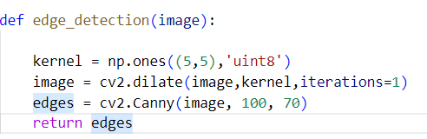
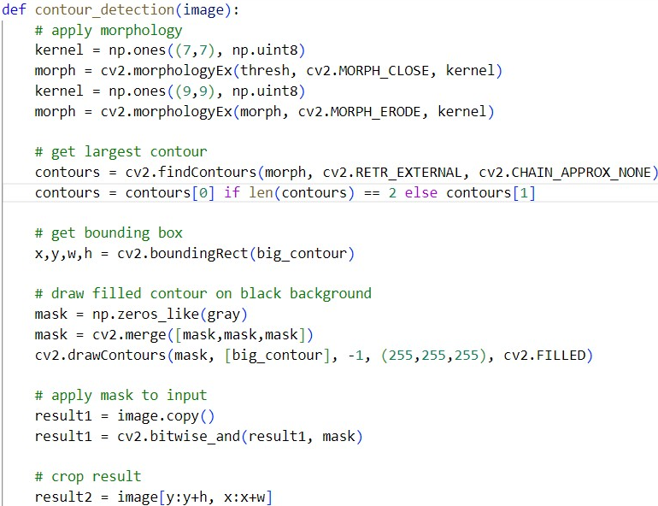
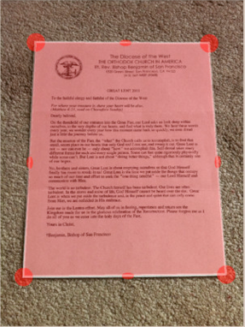
Document Detection

Slide 15
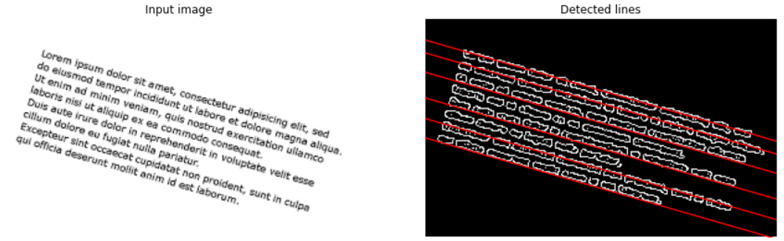
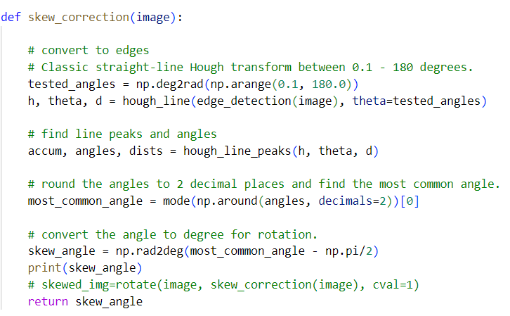
Image Skewness

Slide 16
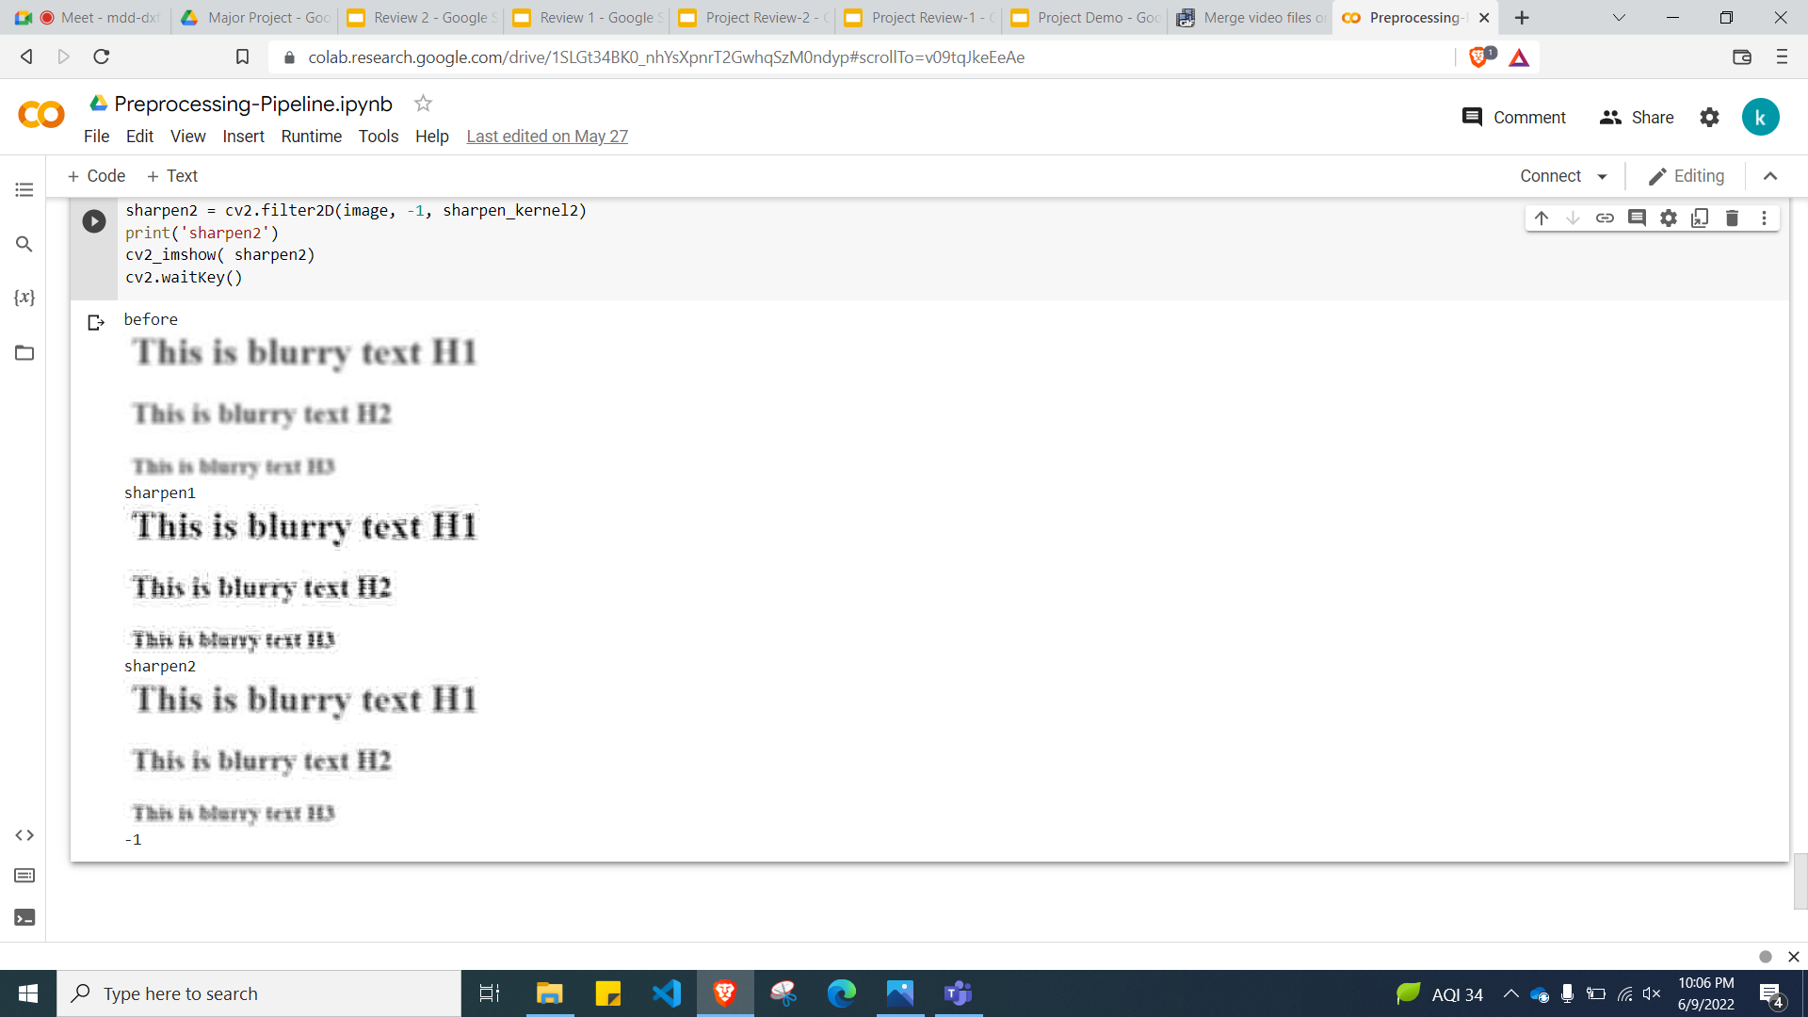
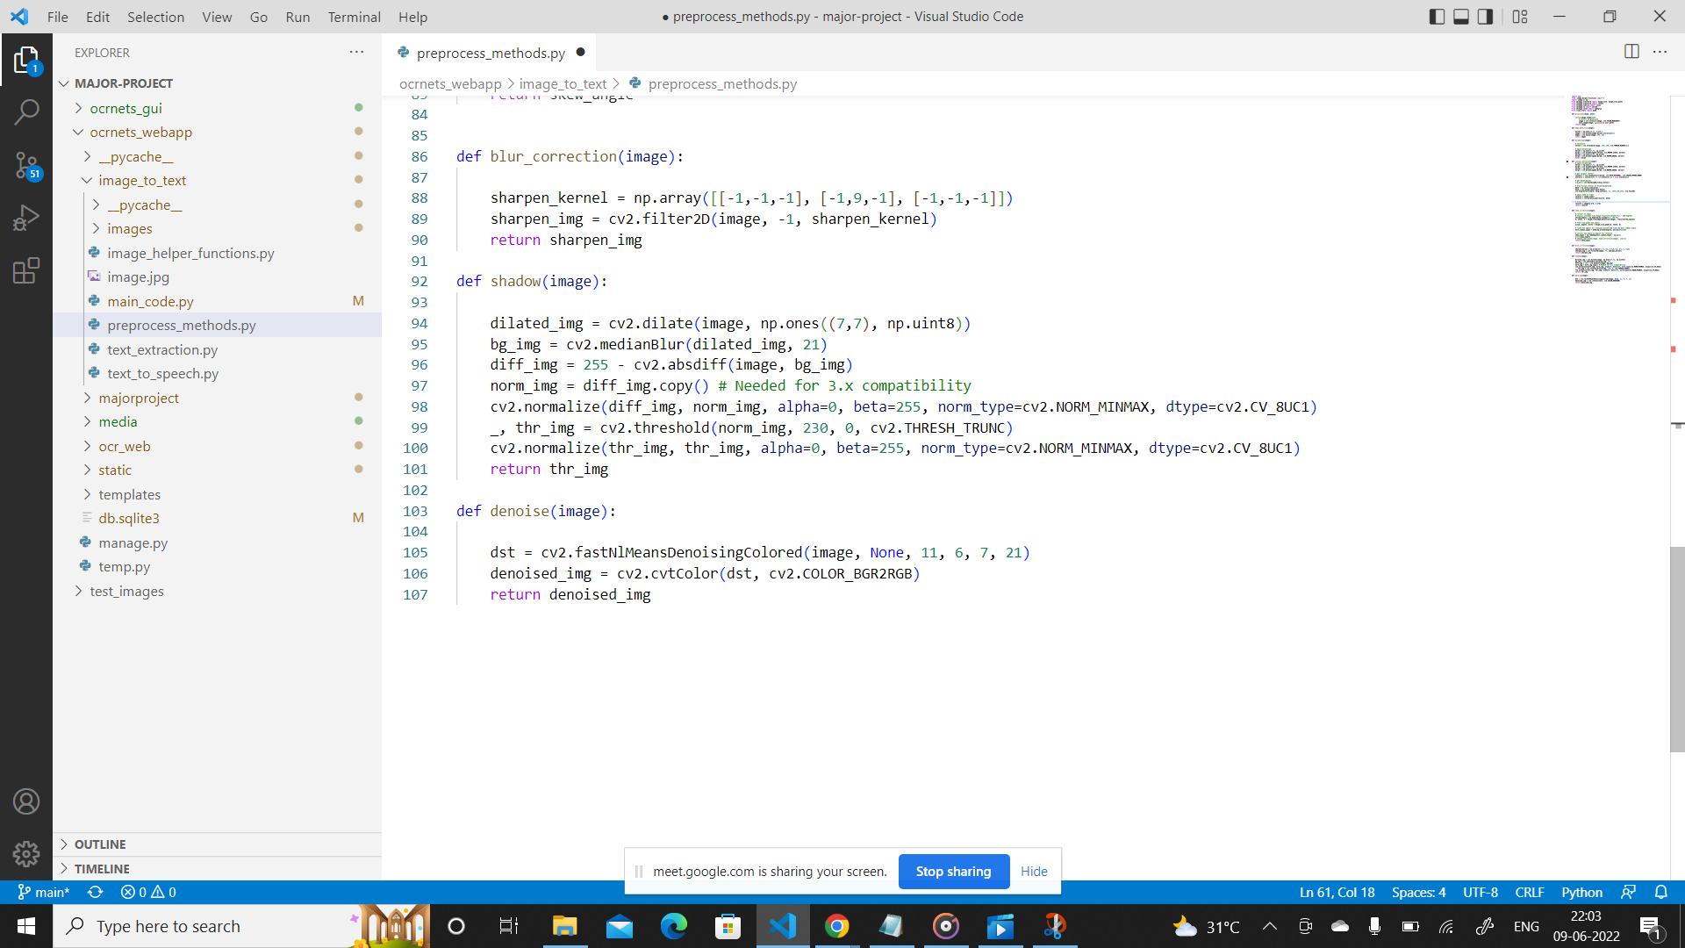
Deblurring
Blurred Image
Deblurred image with kernel [[-1,-1,-1],[-1,9,-1],[-1,-1,-1]]
Deblurred image with kernel [[0, -1, 0],[-1, 5,-1],[0, -1, 0]]

Slide 17
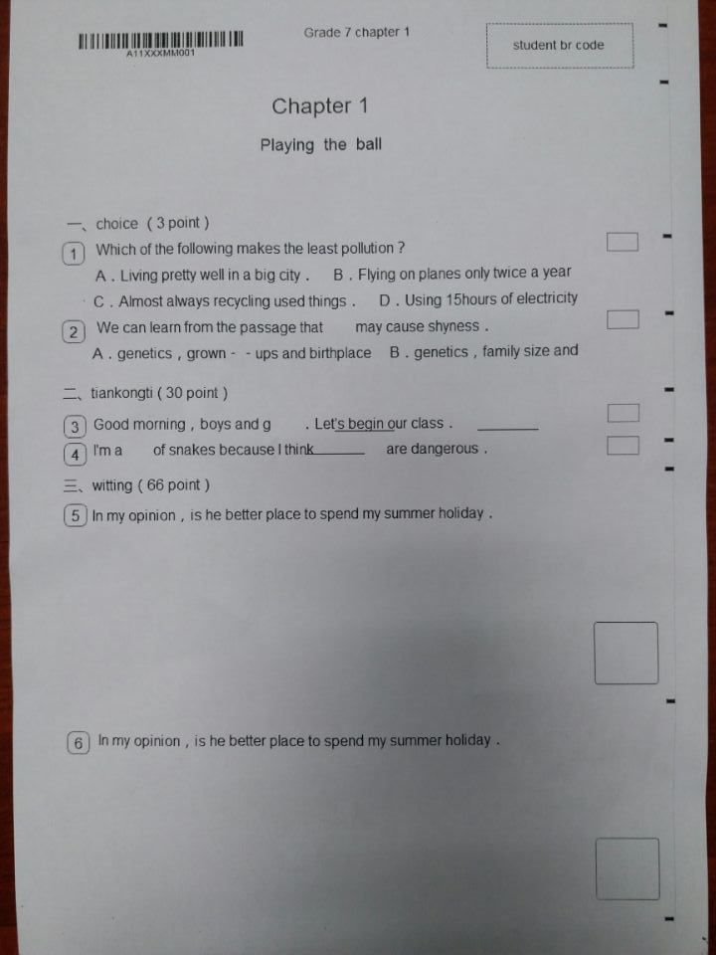
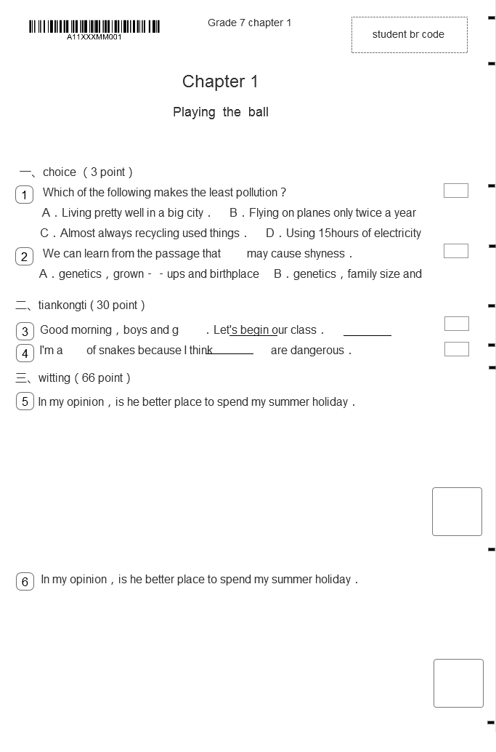
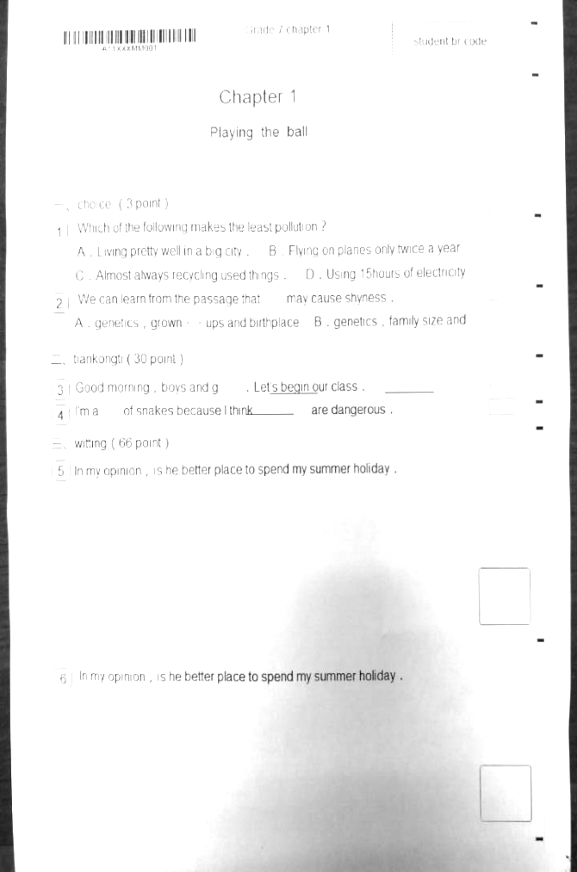
Shadowed Image
Input image
Notes:
Soumya

Slide 18
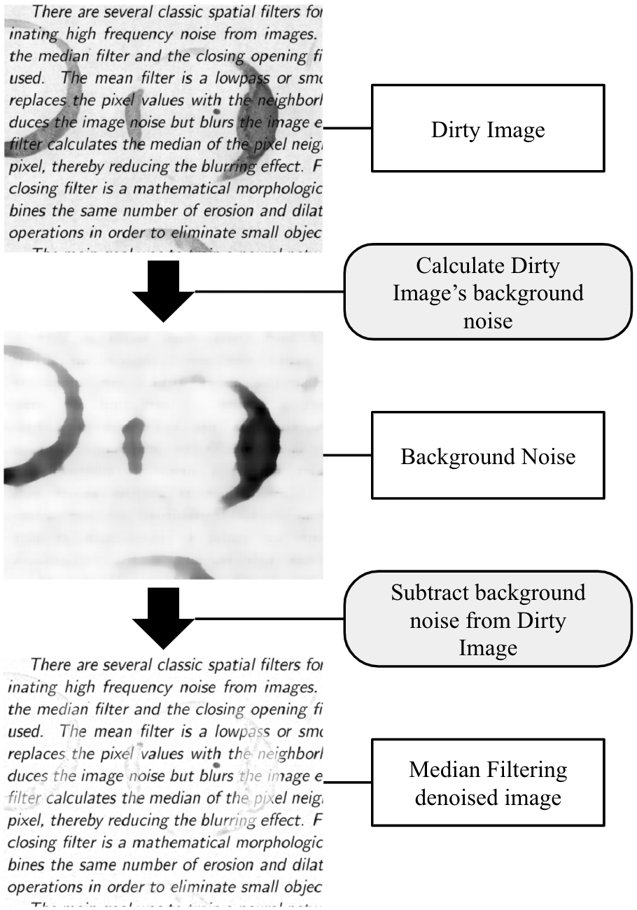
Noise Removal
Output denoised image
Notes:
Soumya

Slide 19
Scanned Image File Upload
Image Preprocessing Pipeline
Optical Character Recognition
Text Extraction
Information Extraction
Text - to - Speech Conversion
Document
Scan
Notes:
Soumya
Preprocessing pipeline workflow
Speech to text

Slide 20
Result

Slide 21
Images used in our dataset contained a count of words ranging from 800 to 1500 words per document. We observed an average error rate of 11% at word level.
The entire processing of the image to the conversion to speech takes about 3-5 seconds.

Slide 22
Where can it be used?

Slide 23
Government ID cards verification
Used in manufacturing and retail companies to digitize invoices, receipts
Used in banking industry to archive customer’s paperwork, account number etc leading to enhanced user experience
Creating calendar events from brochures or flyers
Track of expenditures (digitised)
Digitization of any printed material such as books, records, or forms such as college leave application
Notes:
and purchase orders to track overpayments, duplicate payments, price or quantity mismatch, etc

Slide 24
Application Demo

Slide 25
Conclusion

Slide 26
Thank You

